Slide 1
Word Tutorial 3
Creating a Multiple-Page Report

Slide 2
Objectives
Format headings with Quick Styles
Insert a manual page break
Create and edit a table
Sort rows in a table
Modify a table’s structure
Format a table
New Perspectives on Microsoft Office Word 2007

Slide 3
Objectives
Set tab stops
Create footnotes and endnotes
Divide a document into sections
Create a SmartArt graphic
Create headers and footers
Insert a cover page
New Perspectives on Microsoft Office Word 2007

Slide 4
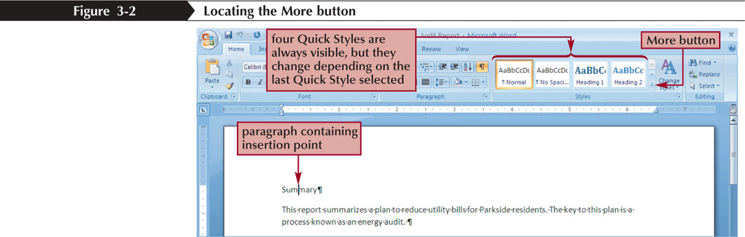
Formatting Headings with Quick Styles
Quick Styles allow you to apply an entire set of formatting choices with one click
  Paragraph-level formatting (formats an entire paragraph)
  Character-level formatting (formats only a few characters or words)
New Perspectives on Microsoft Office Word 2007

Slide 5
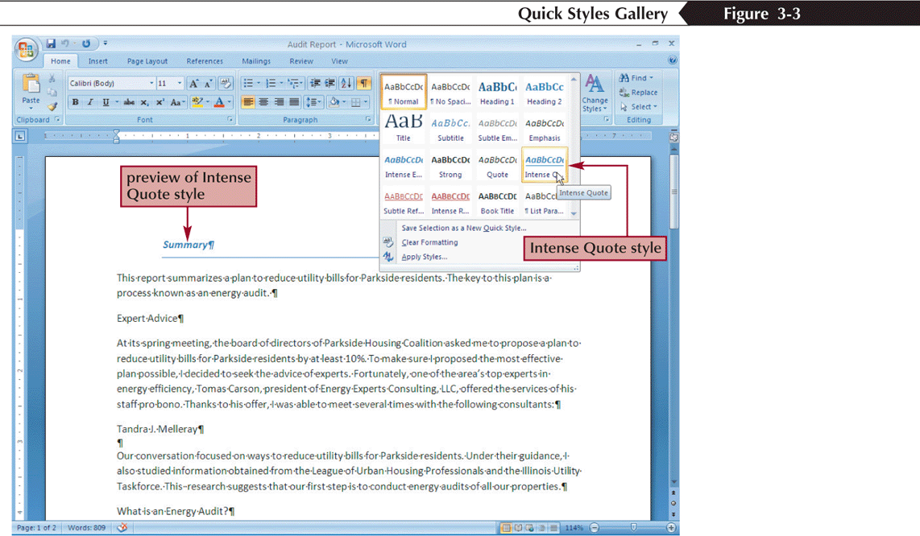
Formatting Headings with Quick Styles
New Perspectives on Microsoft Office Word 2007

Slide 6
Inserting a Manual Page Break
A manual page break is one you insert at a specific location; it doesn’t matter if the previous page is full or not
You insert a manual page break by clicking the Page Break button on the Insert tab or by holding down the Ctrl key and pressing the Enter key
New Perspectives on Microsoft Office Word 2007

Slide 7
Organizing Information in Tables
A table is information arranged in horizontal rows and vertical columns
When you first insert a table into a document, it appears as a simple grid structure, with black gridlines defining the rows and columns
The area where a row and column intersect is called a cell
New Perspectives on Microsoft Office Word 2007

Slide 8
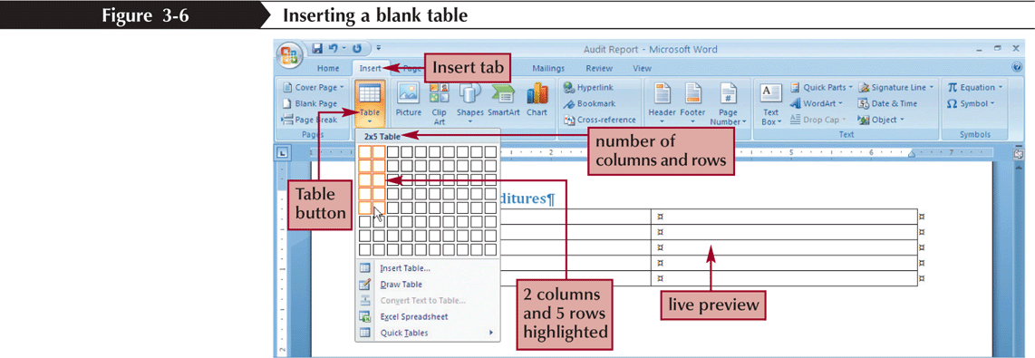
Inserting a Blank Table
Make sure the Insert tab is displayed and then, in the Tables group, click the Table button
New Perspectives on Microsoft Office Word 2007

Slide 9
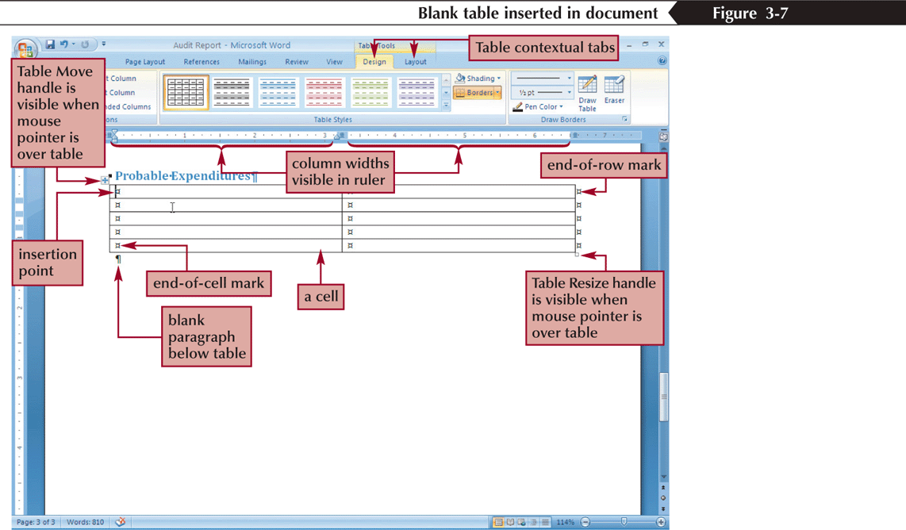
Inserting a Blank Table
New Perspectives on Microsoft Office Word 2007

Slide 10
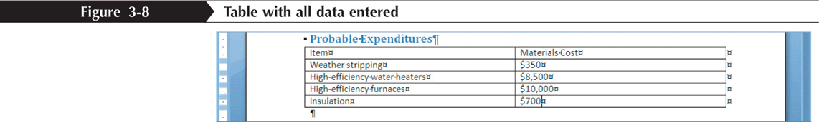
Entering Data in a Table
New Perspectives on Microsoft Office Word 2007

Slide 11
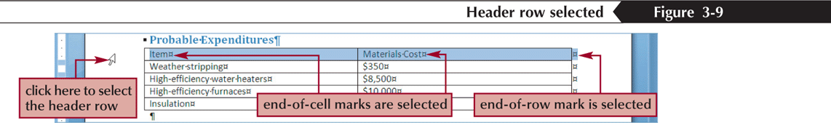
Selecting Part of a Table
As you have learned, you can select the entire table by clicking the Table Move handle
To select part of a table, you can drag the mouse pointer, just as you would to select regular text in a document
New Perspectives on Microsoft Office Word 2007

Slide 12
Sorting Rows in a Table
The term sort refers to the process of rearranging information in alphabetical, numerical, or chronological order
Format the column headers in bold, and then select the entire table
In the Data group on the Table Tools Layout tab, click the Sort button
In the Sort dialog box, click the Sort by arrow, and then select the header for the column you want to sort by. For example, if you want to organize the rows in the table according to the contents of the Last Name column, click “Last Name”
In the Type list box located to the right of the Sort by list box, select the type of information stored in the column you want to sort by. You can choose to sort text, dates, or numbers
New Perspectives on Microsoft Office Word 2007

Slide 13
Sorting Rows in a Table
To sort in alphabetical, chronological, or numerical order, click the Ascending option button. To sort in reverse order, click the Descending option button
If you also want to sort by a second column, click the Then by arrow and click a column header. This is useful if, for example, you want to organize the table rows by last name, and then, within each last name, by first name. You can also specify the type of information in the Then by column, and whether you want to sort in ascending or descending order
Make sure the Header row option button is selected. This tells Word that the table you want to sort includes a header row that should not be sorted along with the other rows
Click the OK button
New Perspectives on Microsoft Office Word 2007

Slide 14
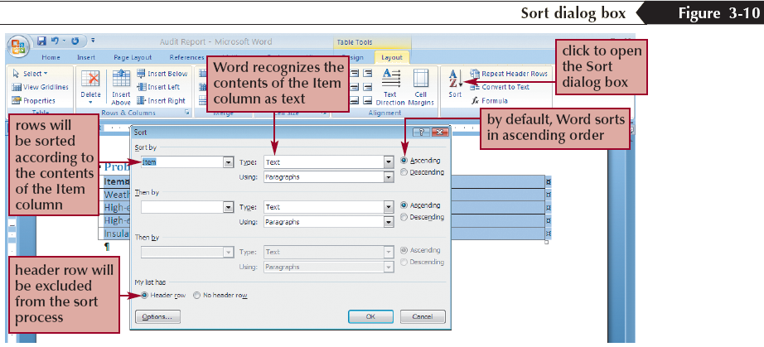
Sorting Rows in a Table
New Perspectives on Microsoft Office Word 2007

Slide 15
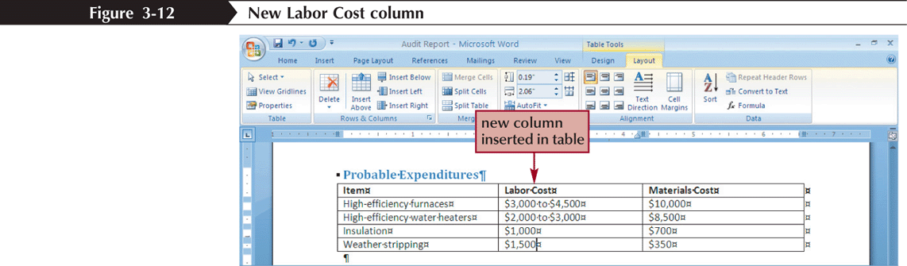
Inserting Rows and Columns in a Table
You will often need to modify a table structure by adding or deleting rows and columns using the Table Tools Layout tab
New Perspectives on Microsoft Office Word 2007

Slide 16
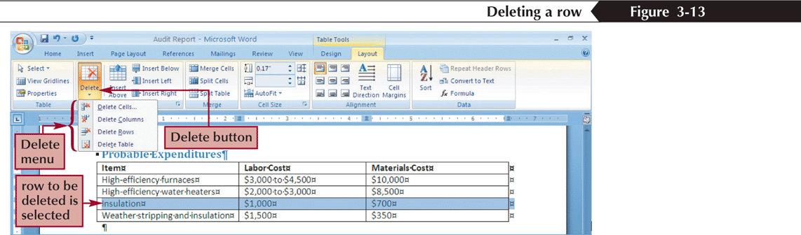
Deleting Rows and Columns
New Perspectives on Microsoft Office Word 2007

Slide 17
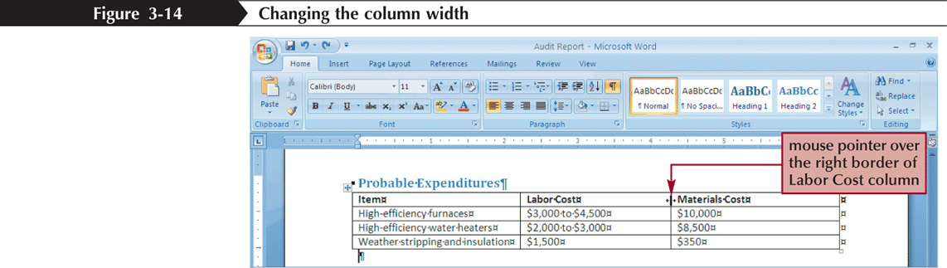
Changing Column Widths
New Perspectives on Microsoft Office Word 2007

Slide 18
Formatting a Table with a Built-In Table Style
Click in the table you want to format, and then click the Table Tools Design tab
In the Table Styles group, click the More button to display the Table Styles gallery
Position the mouse pointer over a style in the Table Styles gallery to see a live preview of the style in the document
In the Table Styles gallery, click the style you want
To apply or remove style elements (such as special formatting for the header row, banded rows, or banded columns), select or deselect check boxes as necessary in the Table Style Options group
New Perspectives on Microsoft Office Word 2007

Slide 19
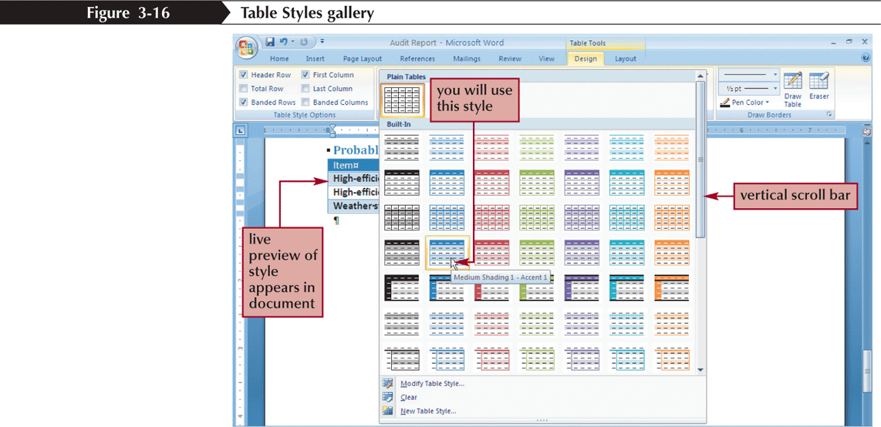
Formatting a Table with a Built-In Table Style
New Perspectives on Microsoft Office Word 2007

Slide 20
Setting Tab Stops
A tab stop (often called just a tab) is a location on the horizontal ruler where the insertion point moves when you press the Tab key
To set a tab stop, click the tab alignment selector on the far left of the horizontal ruler until the appropriate tab stop alignment style appears, and then click the horizontal ruler where you want to position the tab stop. Press the Tab key to move the insertion point to the new tab stop
To align columns as you type, set tab stops on the horizontal ruler (as described in the preceding bullet), type text in the first column, press the Tab key, and then type text at the next tab stop. Continue in this way until you finish typing the first row, with an entry in each column. Then press the Enter key and begin typing the next row
To align text that already contains a nonprinting tab character, select the text and then insert a tab stop on the horizontal ruler
To remove a tab stop, locate it on the ruler, click it, and drag it off the ruler (into the document window)
New Perspectives on Microsoft Office Word 2007

Slide 21
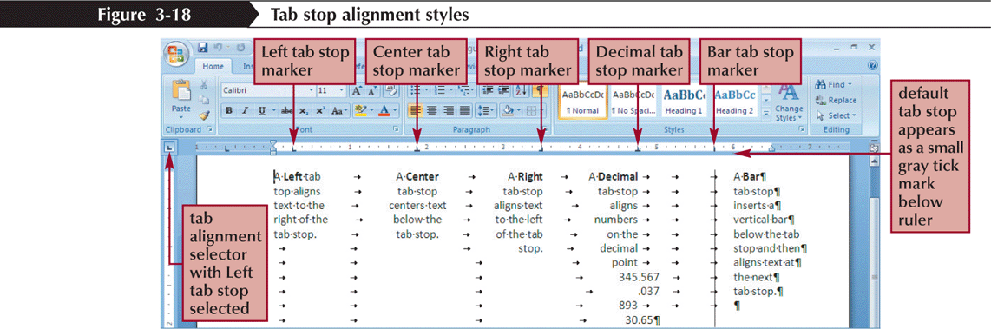
Setting Tab Stops
New Perspectives on Microsoft Office Word 2007

Slide 22
Creating Footnotes and Endnotes
A footnote is an explanatory comment or reference that appears at the bottom of a page
Endnotes are similar, except that the text of an endnote appears at the end of a document
To create a footnote, click where you want to insert a footnote, click the References tab, in the Footnotes group click the Insert Footnote button, and then type the text of the footnote in the bottom margin
To create an endnote, click where you want to insert an endnote, click the References tab, in the Footnotes group click the Insert Endnote button, and then type the text of the endnote at the end of the document
New Perspectives on Microsoft Office Word 2007

Slide 23
Creating Footnotes and Endnotes
When you are finished typing the text of a footnote or endnote, click in the body of the document to continue working on it
To delete a footnote or endnote, delete its reference marker (the small, superscript number) in the text
To edit the text of a footnote or endnote, click in the bottom margin or at the end of the document and edit the note
New Perspectives on Microsoft Office Word 2007

Slide 24
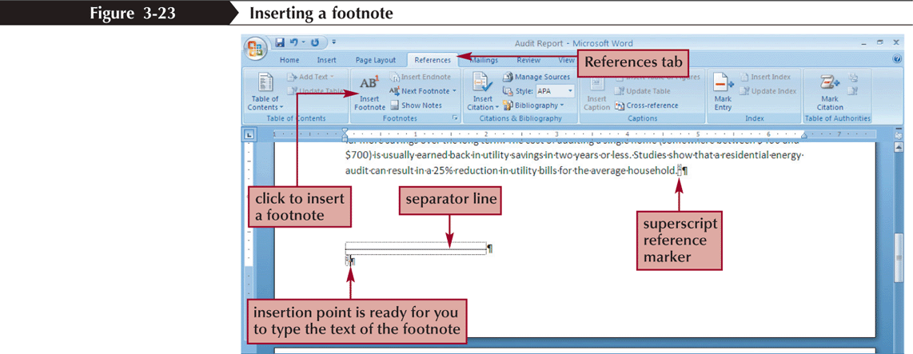
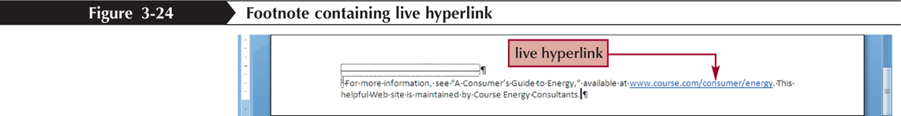
Creating Footnotes and Endnotes
New Perspectives on Microsoft Office Word 2007

Slide 25
Formatting a Document in Sections
A section is a part of a document that can have its own page orientation, margins, headers, footers, and so on
To divide a document into sections, you insert a section break
New Perspectives on Microsoft Office Word 2007

Slide 26
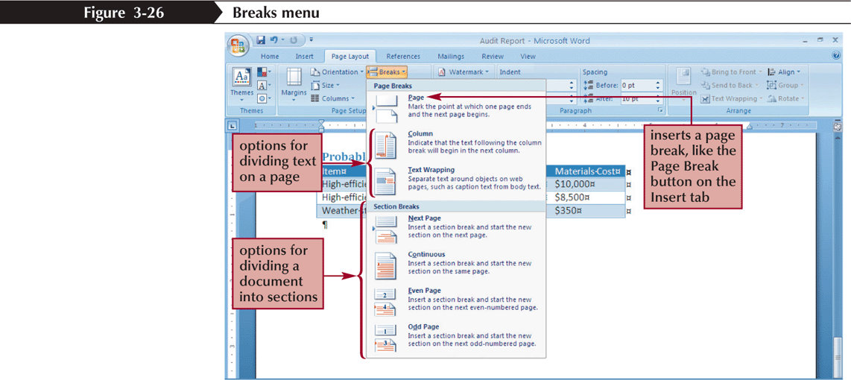
Formatting a Document in Sections
New Perspectives on Microsoft Office Word 2007

Slide 27
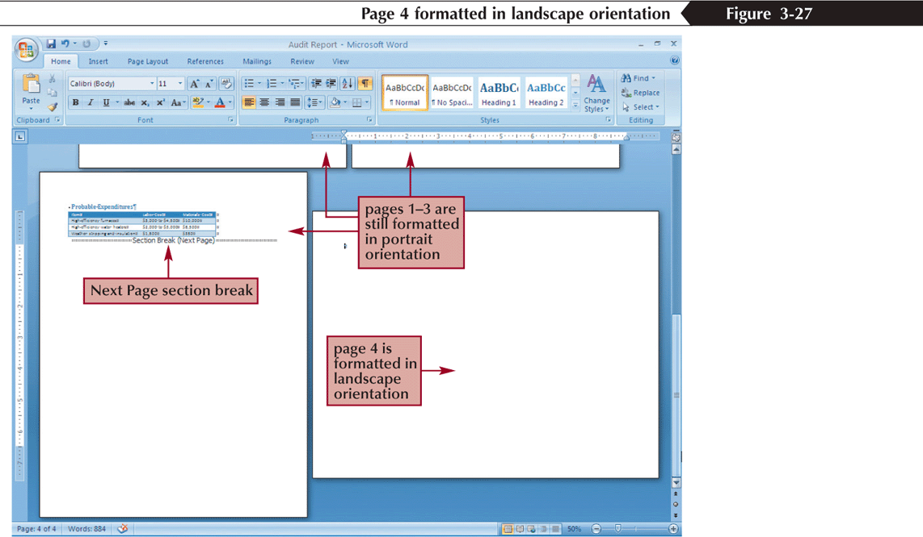
Formatting a Document in Sections
New Perspectives on Microsoft Office Word 2007

Slide 28
Creating SmartArt
The SmartArt feature allows you to create diagrams and charts to illustrate concepts that would otherwise require several paragraphs of explanation
To begin creating a SmartArt graphic, you switch to the Insert tab and then, in the Illustrations group, click the SmartArt button
New Perspectives on Microsoft Office Word 2007

Slide 29
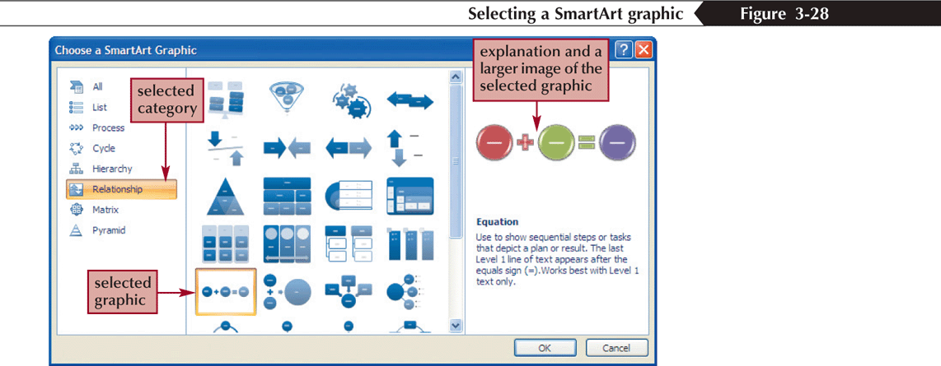
Creating SmartArt
New Perspectives on Microsoft Office Word 2007

Slide 30
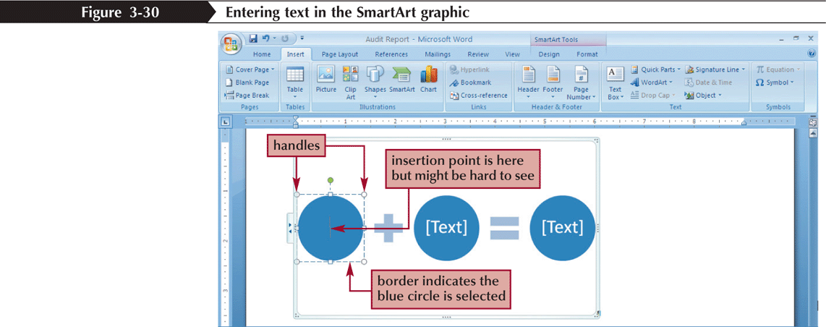
Creating SmartArt
New Perspectives on Microsoft Office Word 2007

Slide 31
Adding Headers and Footers
Text that is printed at the top of every page is called a header
A footer is text that is printed at the bottom of every page
Some headers and footers also include document controls
Double-click the top or bottom margin of a page to switch to Header and Footer view
New Perspectives on Microsoft Office Word 2007

Slide 32
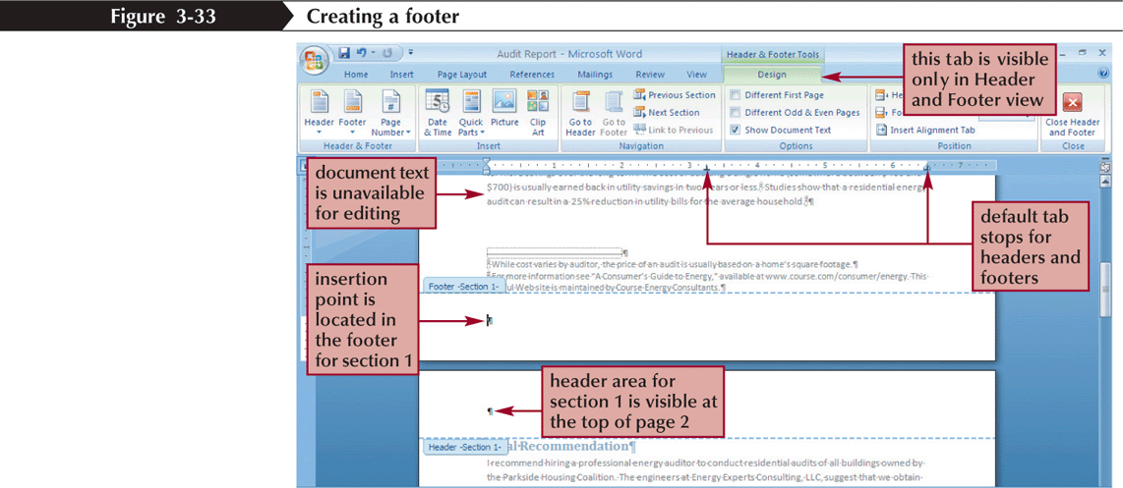
Adding Headers and Footers
New Perspectives on Microsoft Office Word 2007

Slide 33
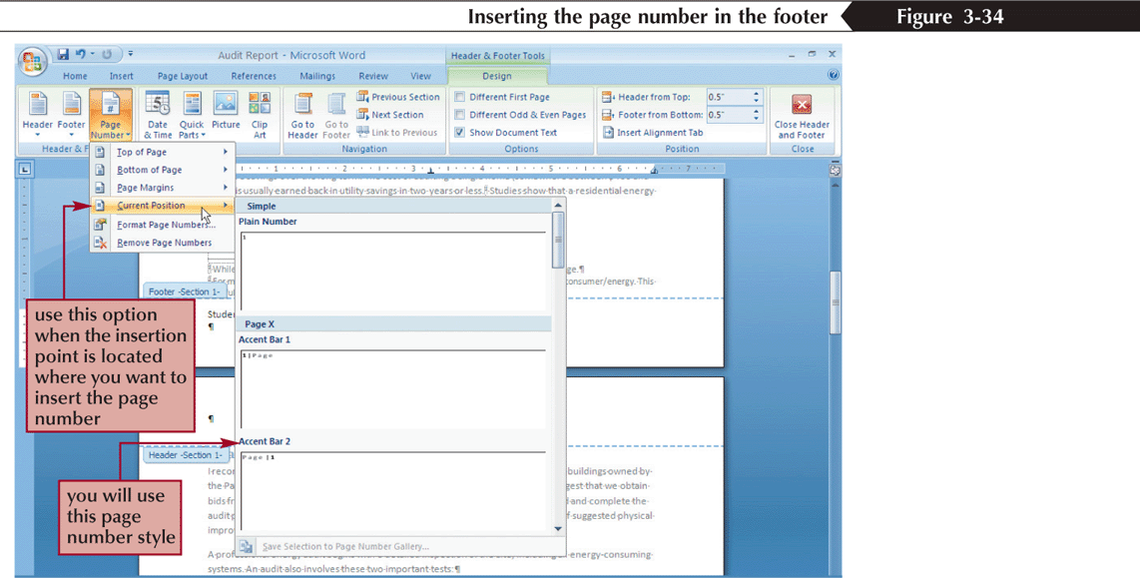
Adding Headers and Footers
New Perspectives on Microsoft Office Word 2007

Slide 34
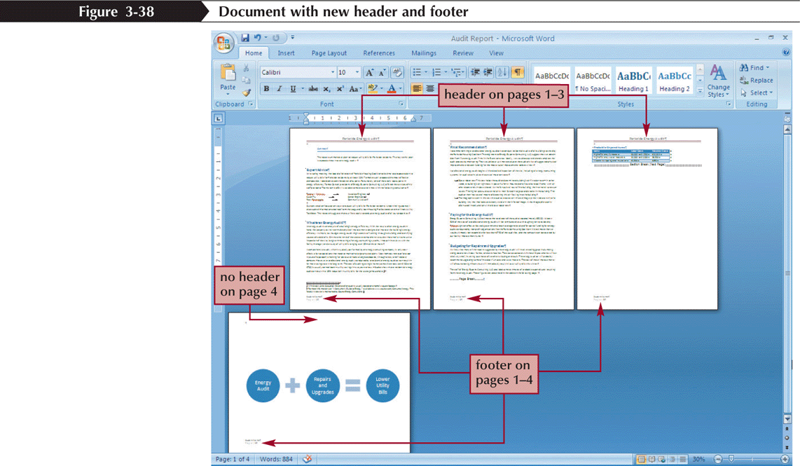
Adding Headers and Footers
New Perspectives on Microsoft Office Word 2007

Slide 35
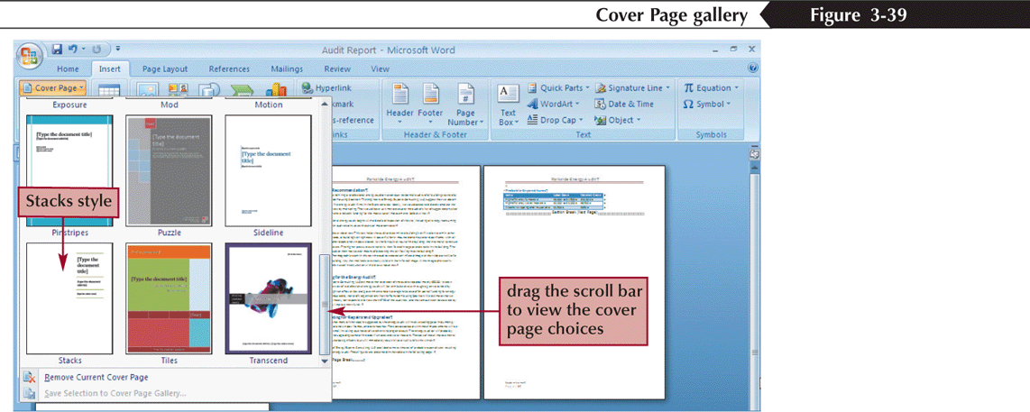
Inserting a Cover Page
A document’s cover page typically includes the title and the author of the report
Click the Insert tab, and then, in the Pages group, click the Cover Page button
New Perspectives on Microsoft Office Word 2007

